Slide 1
Risk stratification of uterine smooth muscle tumors and the application of artificial intelligence (AI)
Marisa R. Nucci, MD
Brigham and Women’s Hospital, Boston, MA

Slide 2
Objectives
Review current understanding of risk stratification for uterine leiomyosarcoma
Discuss potential role of artificial intelligence in helping stratify patients at risk

Slide 3
Predicting Outcome for Patients with LMS
Leiomyosarcoma accounts for approximately 70% of malignant uterine mesenchymal tumors.
Stage remains the principal prognostic factor.
Roughly half of uterine leiomyosarcomas are diagnosed at stage I.
Roughly half of women with stage I uterine leiomyosarcomas die of disease.
The additive prognostic effect of tumor grade remains poorly defined.
Notes:
Stage remains principal prognostic factor with patients at high stage faring worse than low stage however, ~ half of patients diagnosed with stage I and of these half recur/die of disease but we cannot reliably predict which of those patients will recur or die of disease. Additive prognostic effect of tumor grade remains poorly defined as LMS is considered ”high grade”

Slide 4
“Low” vs. “High”-grade Uterine Leiomyosarcoma
Vast majority of research on uterine LMS has been on tumors that are considered “high grade”
”Low grade” leiomyosarcoma is an entity that has not been well defined
Notes:
First point of discussion in patient prognostic stratification is to address the concept of low grade LMS

Slide 5
“Low grade” leiomyosarcoma
Recurrent STUMP → biologically leiomyosarcoma but more indolent behavior that “high grade” LMS
Tend to express ER/PR
Successful treatment with hormonal therapy
Difficult to identify prospectively [most considered STUMP or (cellular) leiomyoma]
Notes:
These exist based on the observation that recurrent STUMP…

Slide 6
STUMP →“Low-grade” leiomyosarcoma
27 consecutive patients
Median age at diagnosis was 43 years
Stage was IA-IB in more than 70% of patients
In these patients, median time to relapse was 62 months
Sites of first relapses were mostly pelvis and peritoneum (76%)
After a median follow-up of 49 months, 14 patients (52%) had a partial response while 10 (37%) had a minor response or stable disease
Sanfilippo R Clin Cancer Res. 2023 Nov 14;29(22):4679-4684.
Notes:
Concept nicely illustrated in this series
Low grade LMS is sensitive to hormonal treatment

Slide 7
Smooth Muscle Tumor of Uncertain Malignant Potential (STUMP)
Tumors with atypia, without necrosis, and sub-diagnostic mitotic activity (6 to 9/10HPF) OR atypical mitotic figures with any mitotic activity
Tumors with tumor cell necrosis but no other features
Tumors without atypia or necrosis, but very high mitotic activity (>15 mits/10HPF)
Tumors in which limited natural history is available
Epithelioid or myxoid tumor with any degree of cytologic atypia OR intermediate proliferative activity (myxoid < 2 mitoses/10 hpf; epithelioid 1-3 mitoses/10 hpf) OR tumor cell necrosis
Myometrial infiltration in the absence of “canonical“ features of malignancy
Notes:
How is STUMP defined. Heterogeneous category – some of these are “high grade” tumors that we cannot recognize as such. Some are probably not even malignant (high mitotic activity). Some of called STUMP because they are rare and we have very little data. However, there are some that I think are related to low grade LMS, particularly ones in which have tumor cell necrosis but no other features (admittedly rare) but in particular tumors that show myometrial infiltration…..
7

Slide 8
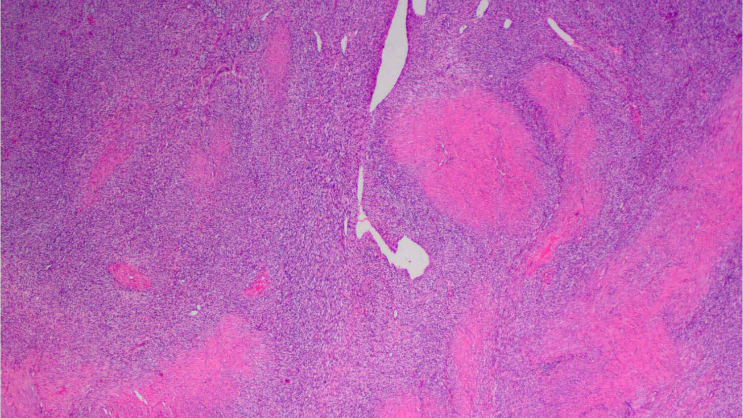

Slide 9
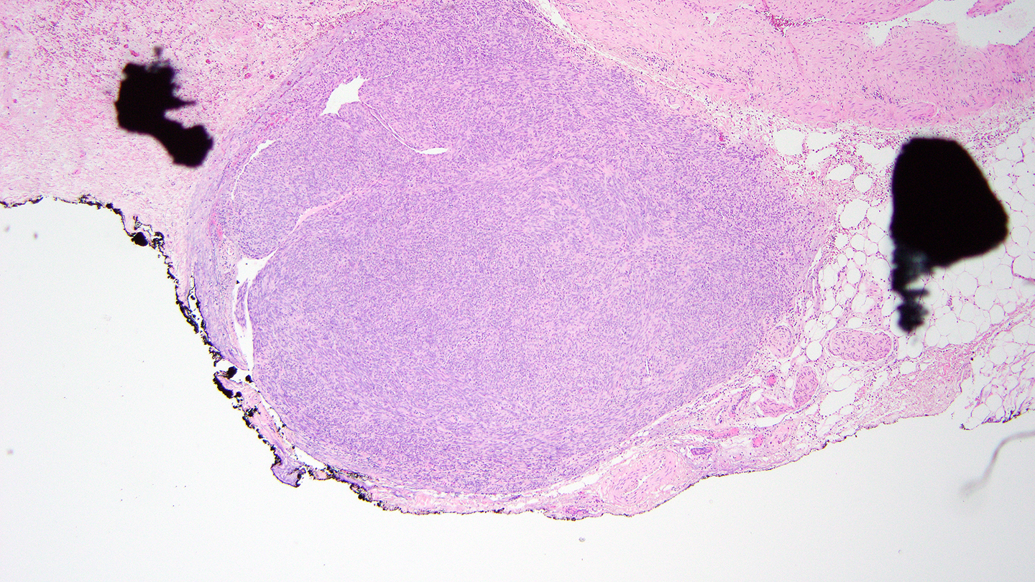

Slide 10
Recognizing “Low-grade” Uterine Leiomyosarcoma
Cellular or Highly cellular
Relatively banal cytology
Long “sweeping” fascicles
Destructive infiltration of myometrium
Vascular invasion
Mitotic count can be high

Slide 11
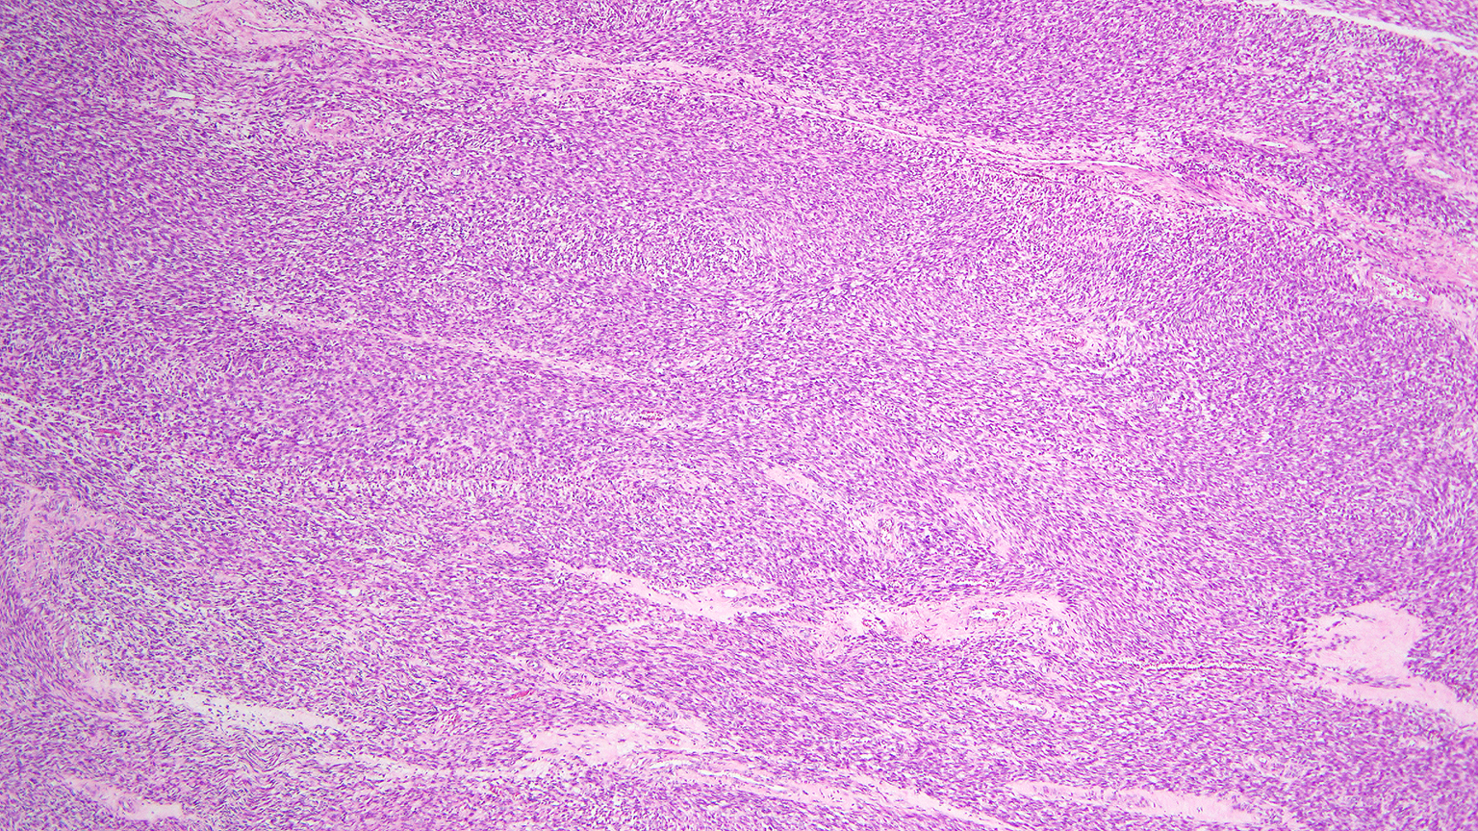

Slide 12
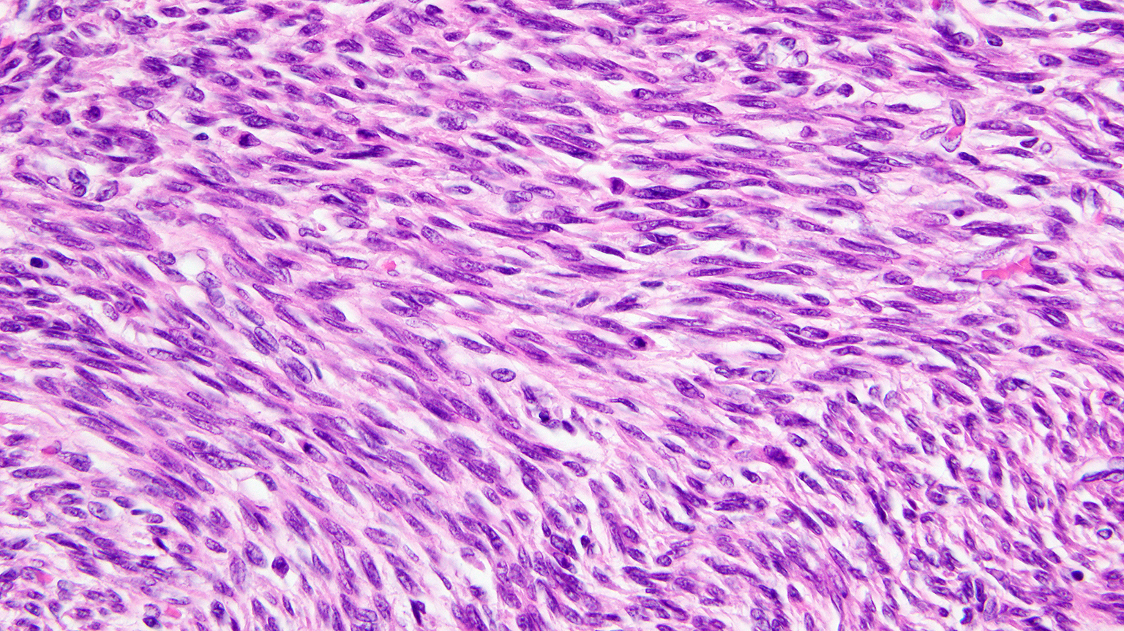

Slide 13
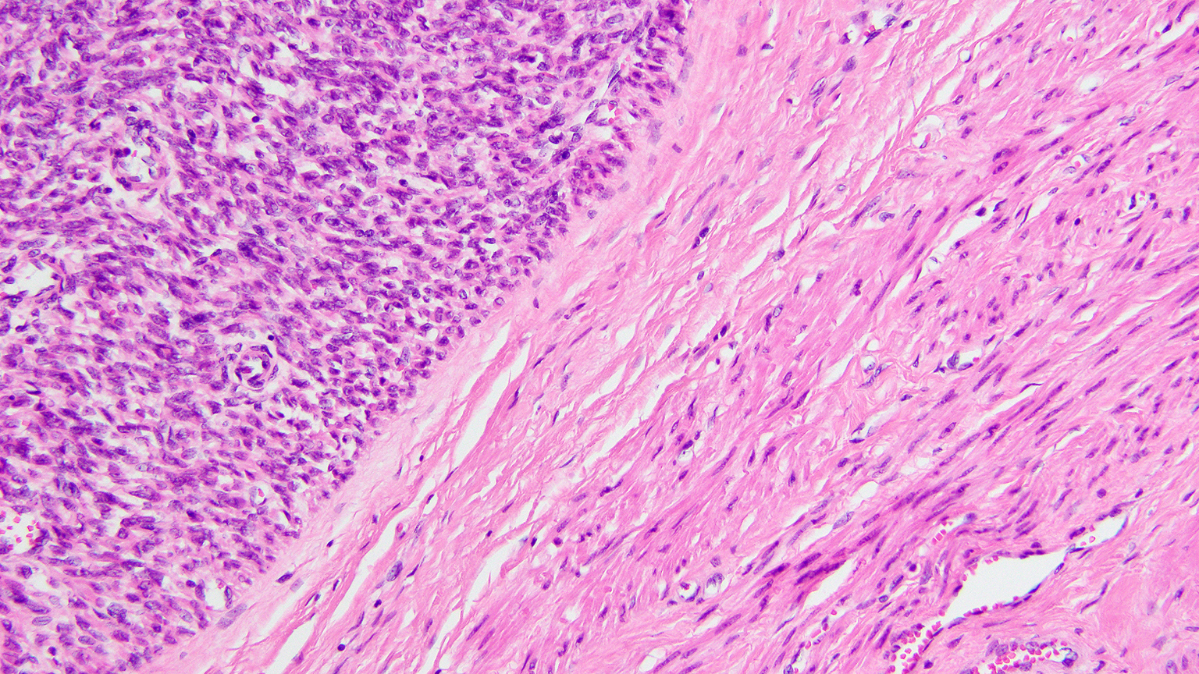

Slide 14
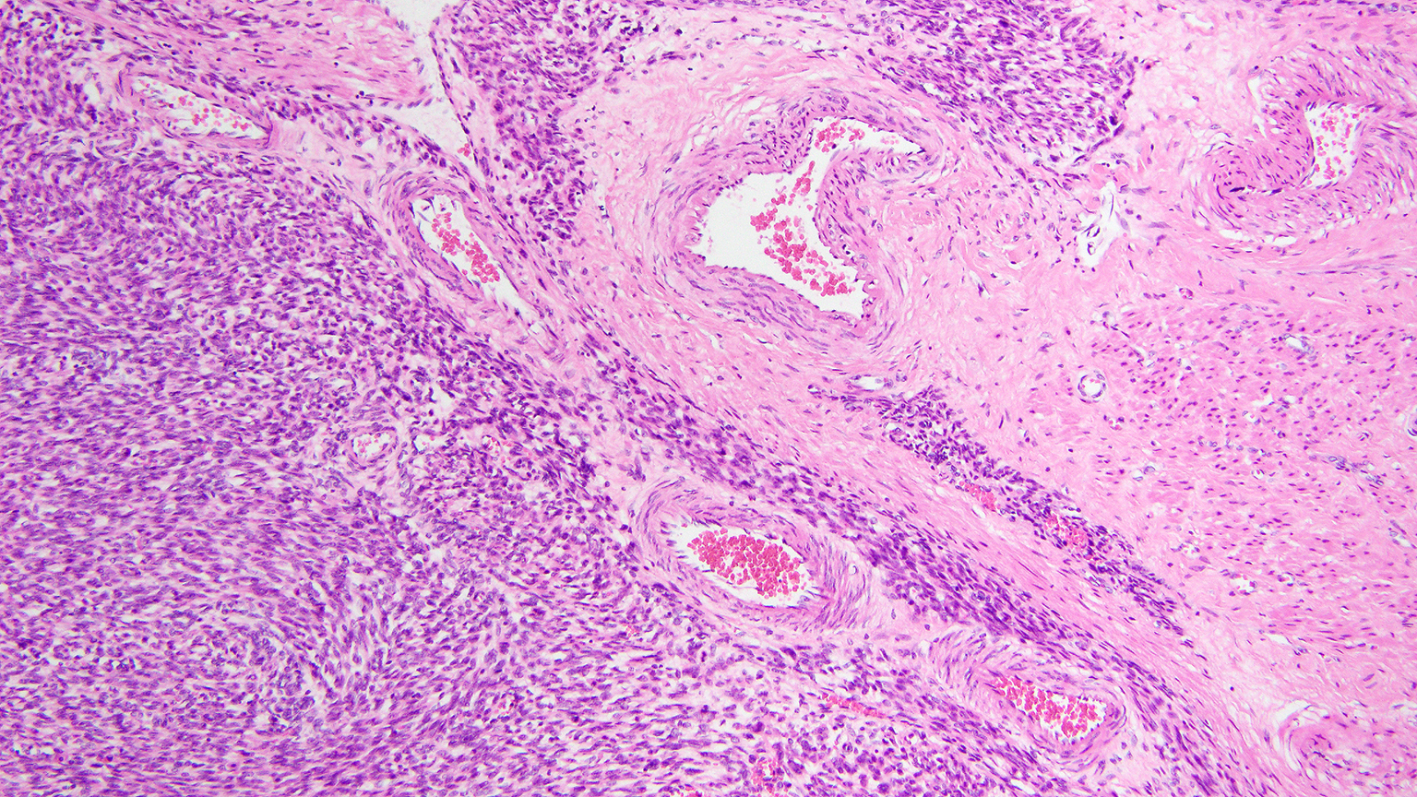

Slide 15
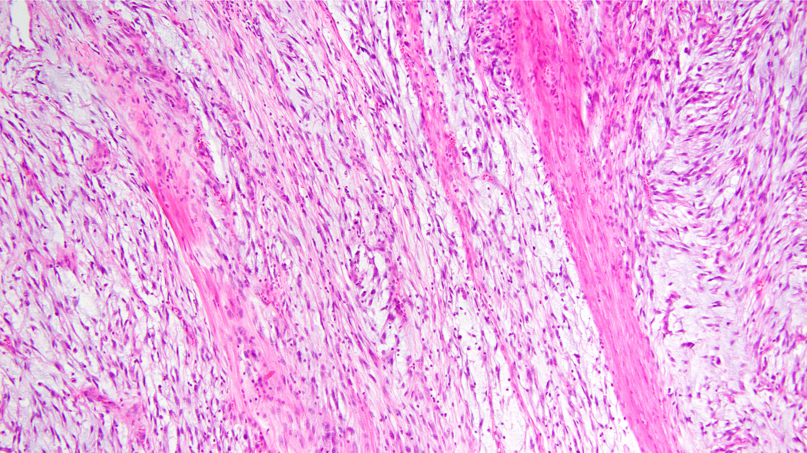
Notes:
As well as show a destructive pattern of infiltration with separation of individual muscle fibers of the myometrium

Slide 16
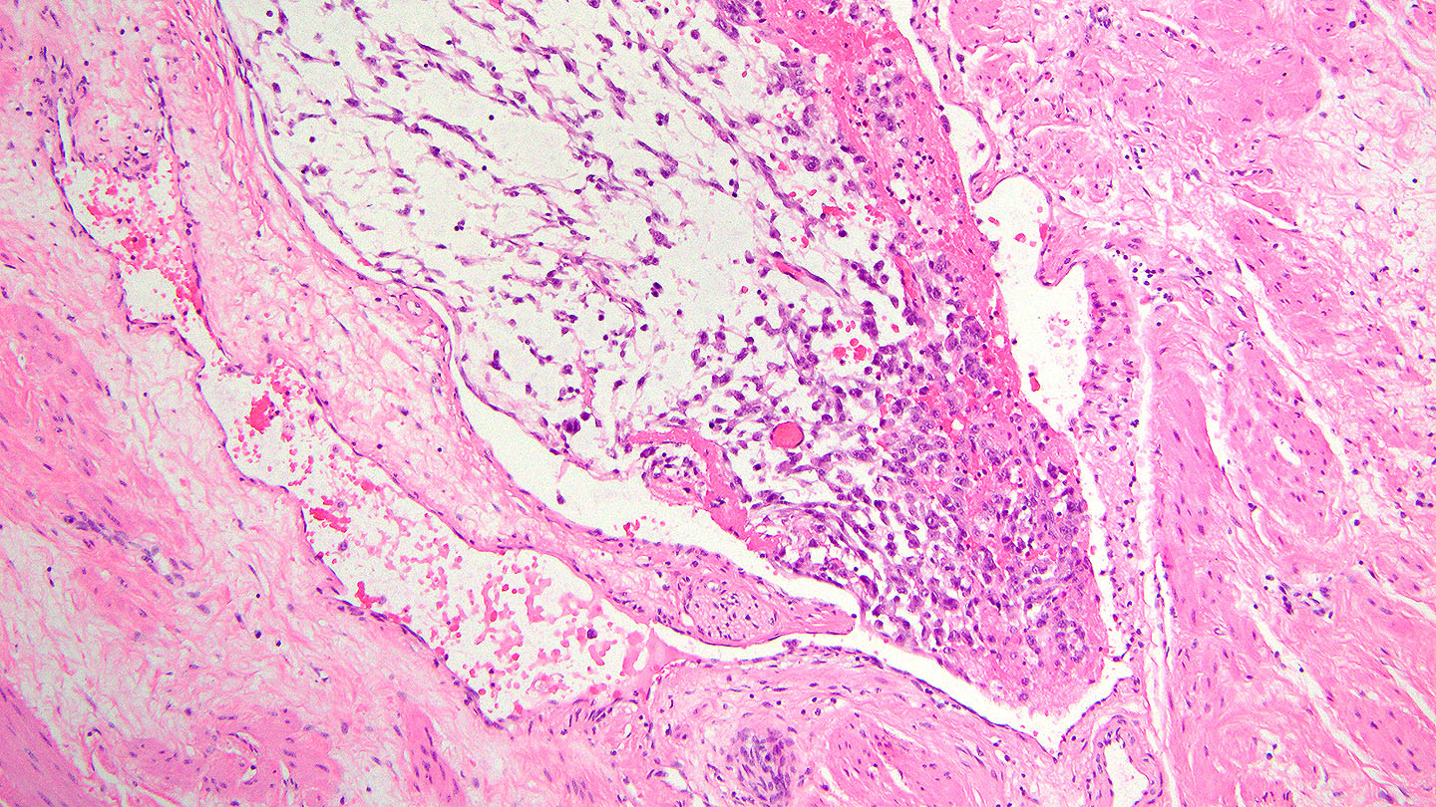
Vascular Invasion

Slide 17
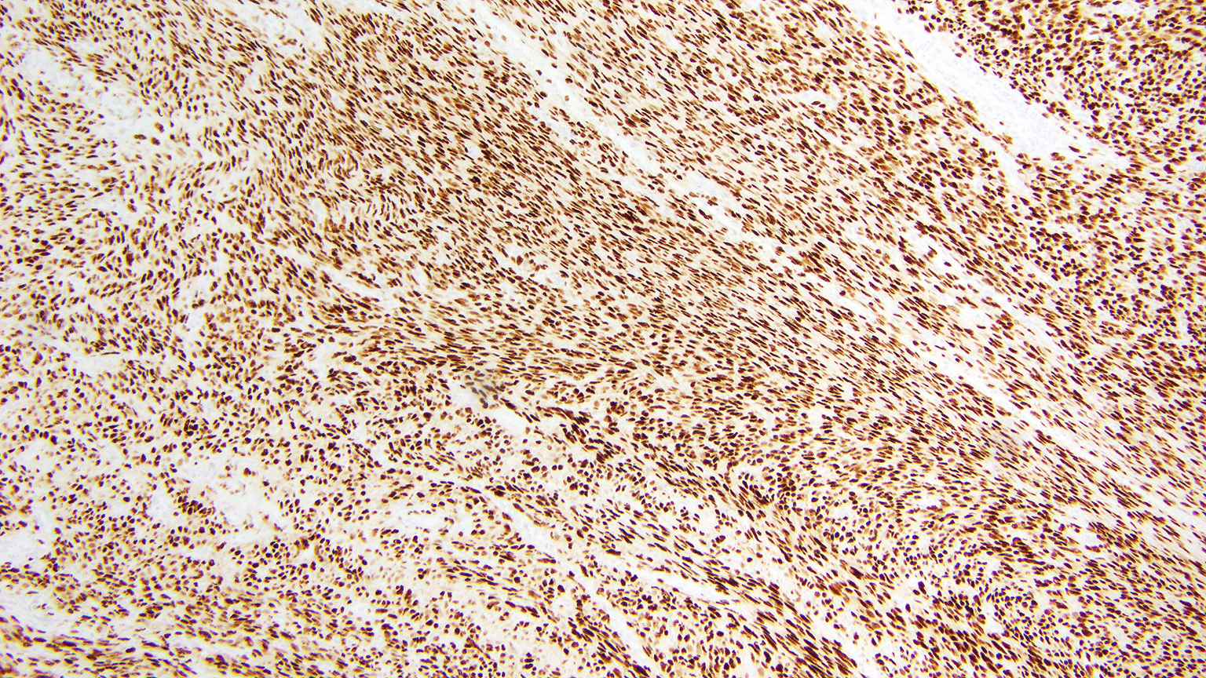
ER/PR positive
Notes:
Strongly express ER/PR

Slide 18
“High” grade leiomyosarcoma

Slide 19
Predicting Outcome for Patients with LMS
Previous work has linked poorer outcomes with:
Poor tumor circumscription
Elevated mitotic count
Vascular invasion
Non-spindled morphology
Cytologic atypia
Giuntoli RL. Gynecol Oncol. 2003
Pelmus M. Int J Gynecol Cancer. 2009
Wang W-L. Am J Surg Pathol. 2011
Garcia C. Int J Gynecol Cancer. 2015

Slide 20
Predicting Outcome for Patients with LMS
Previous work has linked poorer outcomes with:
Poor tumor circumscription
Elevated mitotic count
Vascular invasion
Non-spindled morphology
Cytologic atypia
Small cohorts
Univariate analyses
Inconsistent results
Giuntoli RL. Gynecol Oncol. 2003
Pelmus M. Int J Gynecol Cancer. 2009
Wang W-L. Am J Surg Pathol. 2011
Garcia C. Int J Gynecol Cancer. 2015

Slide 21
Novel Prognostic Model for Stage I LMS
Create and validate a prognostic model for stage I uterine leiomyosarcoma, for routine use in daily practice
Chapel DB, Sharma A, Lastra RR, Maccio L, Bragantini E, Zannoni GF, George S, Quade BJ, Parra-Herran C, Nucci MR. A novel morphology-based risk stratification model for stage I uterine leiomyosarcoma: an analysis of 203 cases. Mod Pathol. 2022 Jun;35(6):794-807. Epub 2022 Feb 4. PMID: 35121810.

Slide 22
Cohort construction
Inclusion criteria:
Primary uterine leiomyosarcomas (n=610)
Primary management at our institution (n=384)
Stage I (n=216)
H&E slides available for morphologic evaluation n=120
Final cohort: 120 tumors
Diagnosis was confirmed in all cases by morphologic review, review of prior immunohistochemistry, and additional immunohistochemical stains, where needed and possible.

Slide 23
Evaluated parameters
Clinical:
Age at diagnosis
Treatment history
Morcellation
Outcomes:
Time to recurrence
Time to death
Cause of death
Pathologic:
Tumor size
Circumscription
Dominant morphology
Nuclear atypia
Mitotic count
Atypical mitoses
Coagulative necrosis
Lymphovascular invasion
Serosal involvement
Margin status

Slide 24
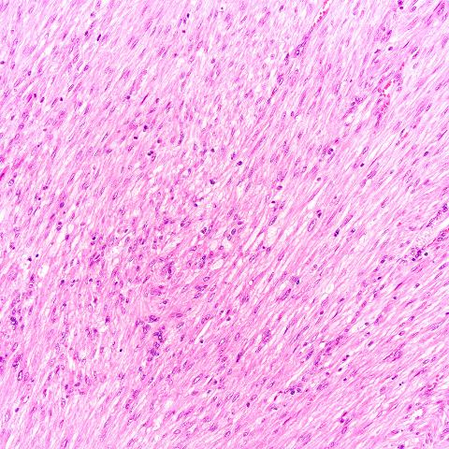
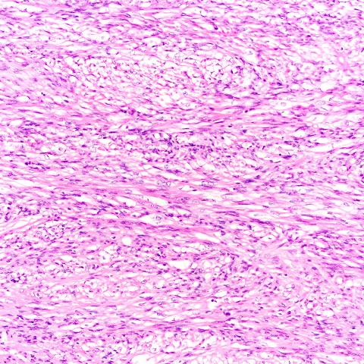
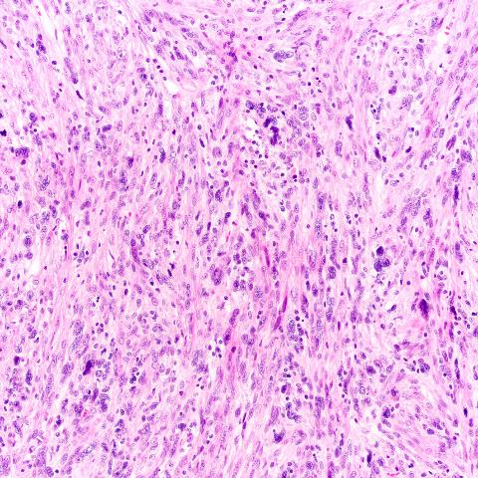
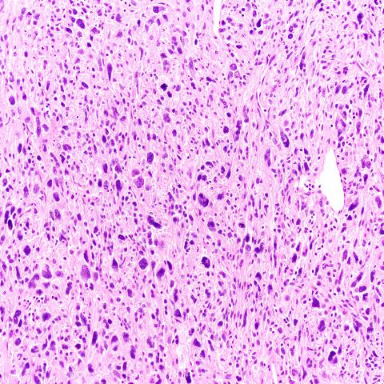
Nuclear atypia
Application of the four-tier Broders classification system, as applied to uterine leiomyosarcoma by Giuntoli, et al.
Giuntoli RL. Gynecol Oncol. 2003.
Grade 1
Grade 2
Grade 3
Grade 4
Giuntoli RL. Gynecol Oncol. 2003.

Slide 25
Atypical mitoses
Defined rather narrowly as multipolar mitoses or mitoses with bizarre spindles, using published criteria to distinguish atypical mitoses from apoptotic cells
Baak JP. Hum Pathol. 1990.

Slide 26
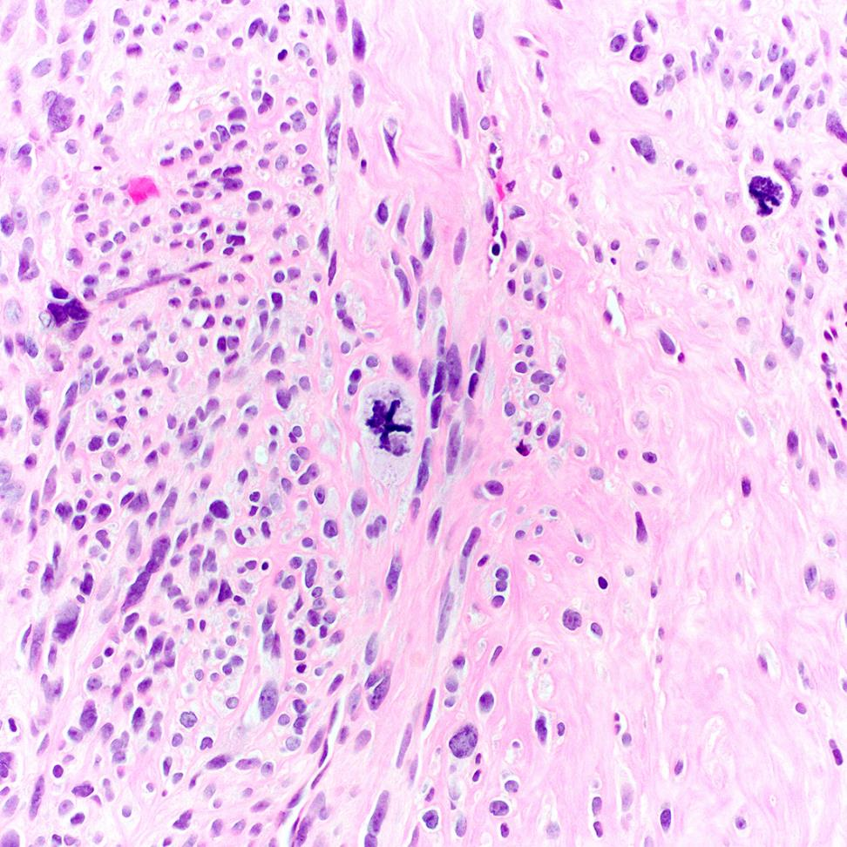
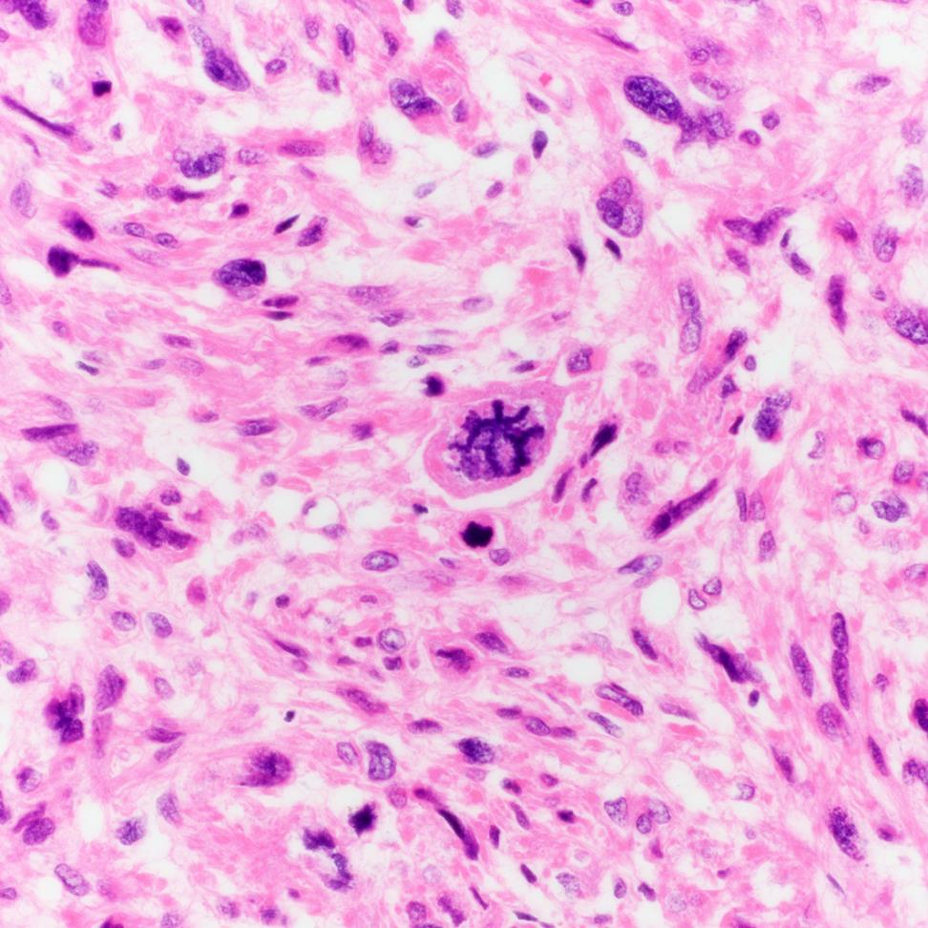
Baak JP. Hum Pathol. 1990.

Slide 27
Lymphovascular invasion
Definitive pattern
Tumor plugs circumferentially contained by myometrial vessels outside of the tumor mass
Incipient pattern
Tumor non-circumferentially “nosing” into myometrial vessels outside of the tumor mass

Slide 28
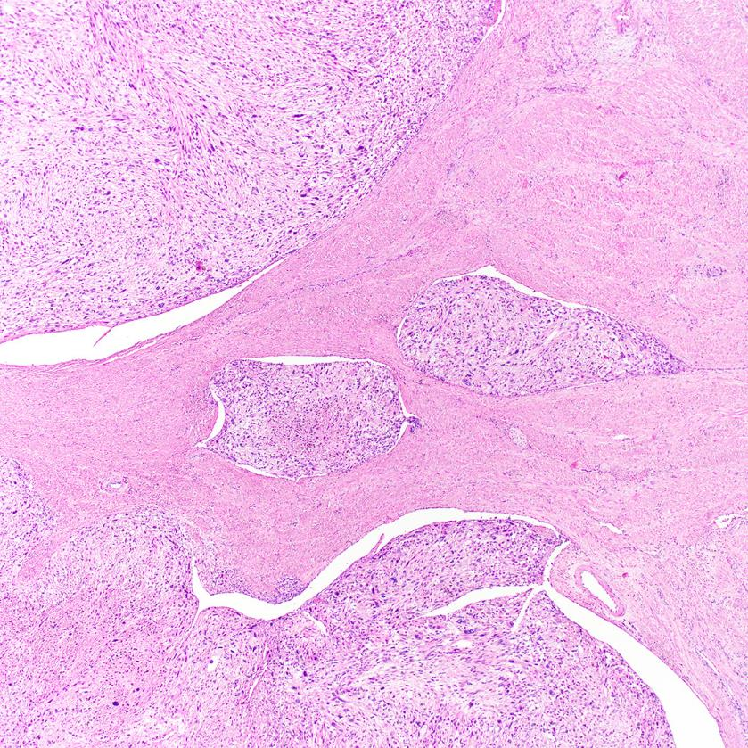
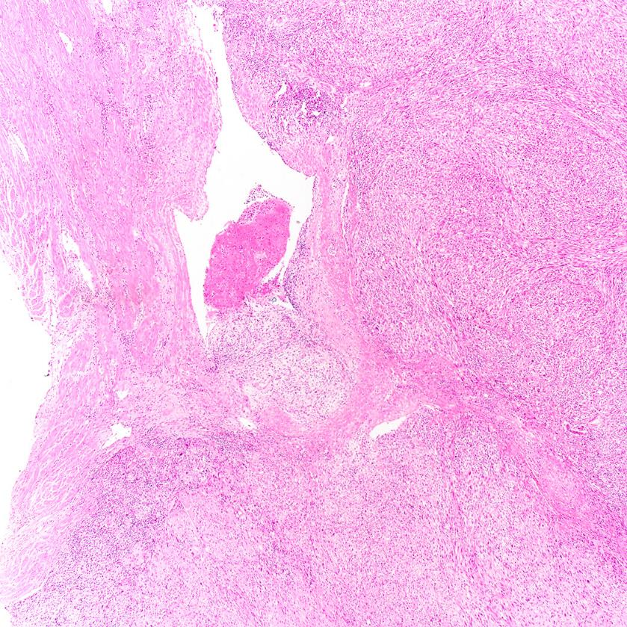
Lymphovascular invasion (LVI)
Definitive LVI
Incipient LVI

Slide 29
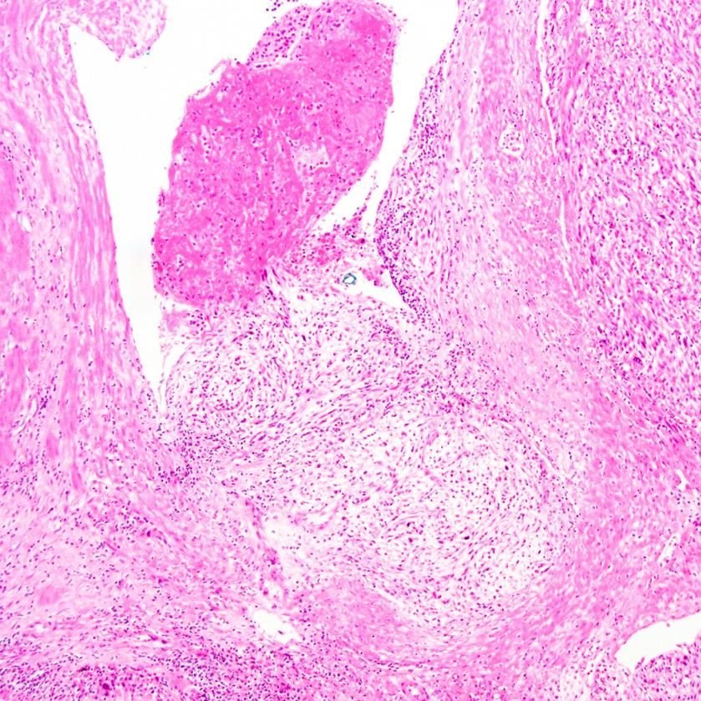
Lymphovascular invasion
Definitive LVI
Incipient LVI

Slide 30
Serosal involvement
Tumor invasion through the myometrium, to or through the serosal surface, such that the native myometrial fibers between tumor and serosa are effaced.

Slide 31
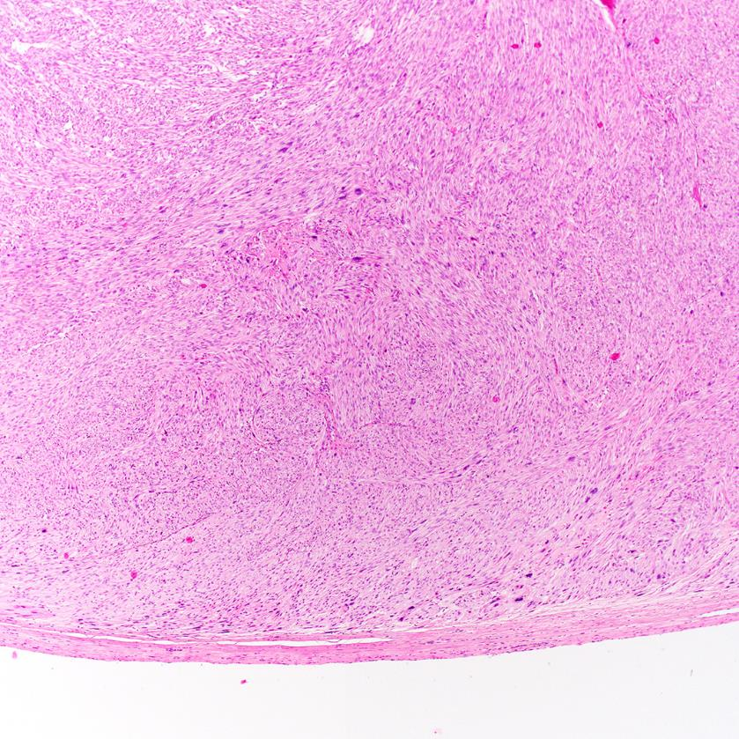
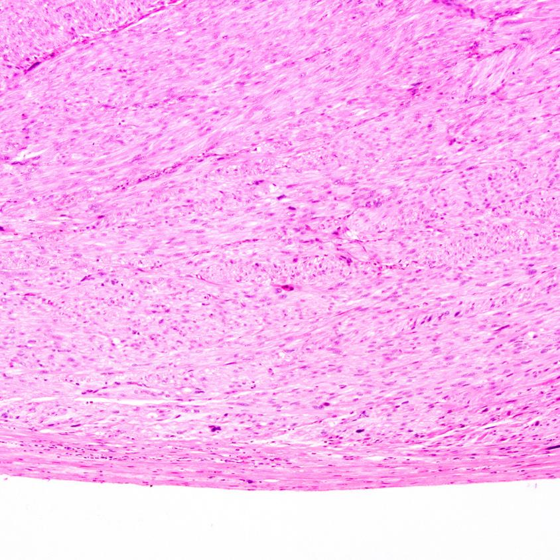
Serosal involvement

Slide 32
Final cohort
120 uterine leiomyosarcoma
~60% recurred (median 12 months; range 1-132 months)
Continuous survival data were converted into a binary outcome metric – recurred versus long term disease free survival
“Long-term disease-free survival” defined as:
No recurrence or evidence of disease at any time point
At least 60 months of follow-up
Among long-term disease-free survivors, median follow-up was 9.5 years, and ranged up to 31 years

Slide 33
Multiple morphologic parameters are significantly associated with survival on univariate analysis.
Disease-free survival:
HR P
Mitoses ≥25/10 hpf 3.0 <0.0001
Atypical mitoses 2.5 0.0003
Coagulative necrosis 3.1 0.0003
Lymphovascular invasion 2.6 0.001
Serosal involvement 3.2 <0.0001
Margin involvement 3.5 0.01
Overall and disease-specific survival:
HR P
Mitoses ≥25/10 hpf 3.0 0.0001
Atypical mitoses 2.2 0.01
Coagulative necrosis 2.4 0.009
Lymphovascular invasion 3.0 <0.0001
Serosal involvement 2.7 0.0002

Slide 34
Multiple morphologic parameters are significantly associated with survival on univariate analysis.
Disease-free survival:
HR P
Mitoses ≥25/10 hpf 3.0 <0.0001
Atypical mitoses 2.5 0.0003
Coagulative necrosis 3.1 0.0003
Lymphovascular invasion 2.6 0.001
Serosal involvement 3.2 <0.0001
Margin involvement 3.5 0.01
Overall and disease-specific survival:
HR P
Mitoses ≥25/10 hpf 3.0 0.0001
Atypical mitoses 2.2 0.01
Coagulative necrosis 2.4 0.009
Lymphovascular invasion 3.0 <0.0001
Serosal involvement 2.7 0.0002
No association between treatment history and survival.
Definitive and incipient LVI equally associated with poor outcome.

Slide 35
Takeaways from multivariate models translated into a weighted formula
Risk Score =
(Serosal involvement)(5) +
(Margin involvement)(5) +
(Lymphovascular invasion)(3) +
(Mitoses ≥25/10 hpf)(2) +
(Atypical mitoses)(2) +
(Coagulative necrosis)(1)
Score range: 0-18

Slide 36
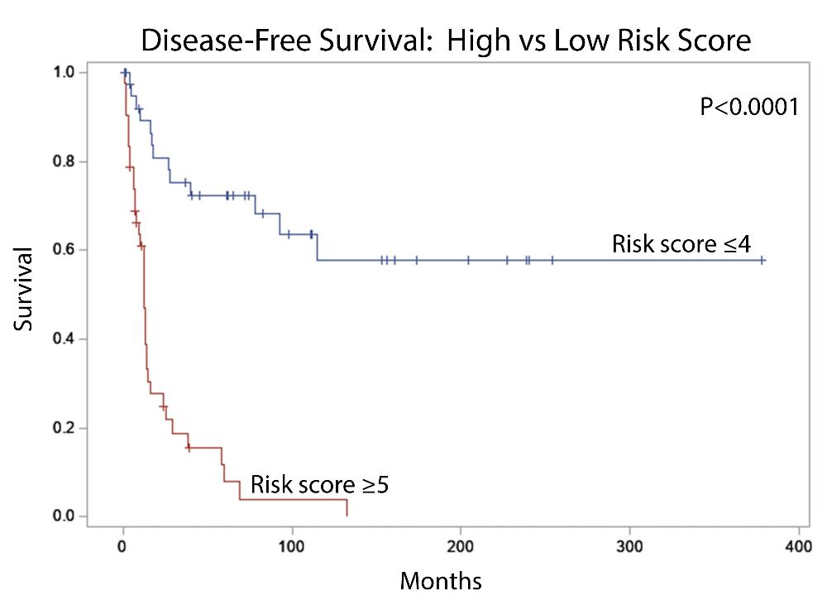
Tumors with high risk (score ≥5) vs low risk (score ≤4) differ markedly in overall and disease-free survival.
Median: n.r.
Median: n.r.
Median: 36 mo.
Median: 12 mo.

Slide 37
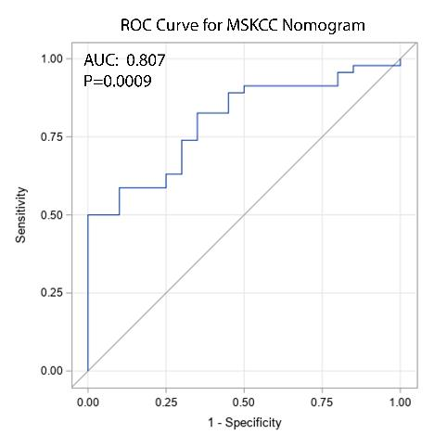
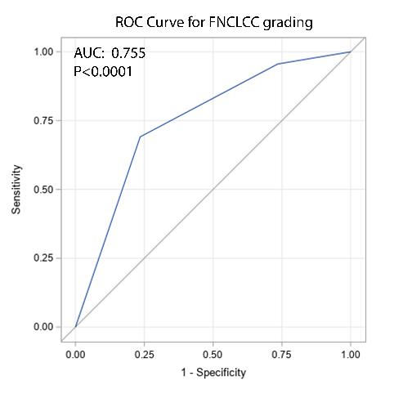
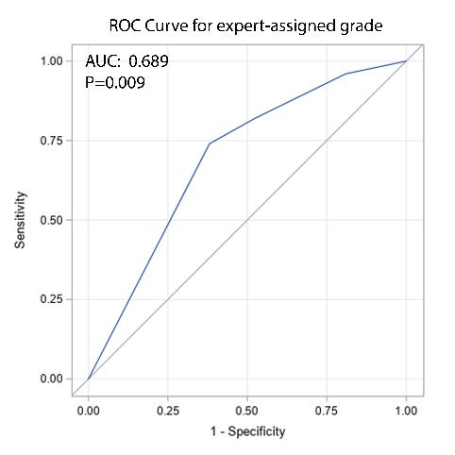
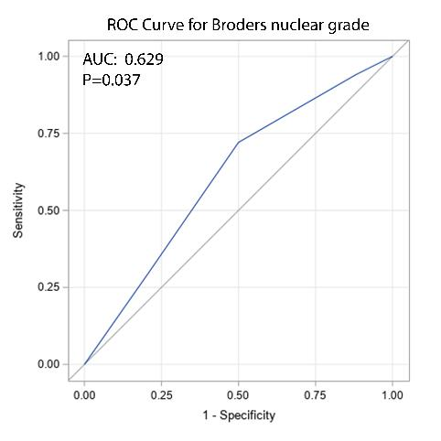
Some existing grading systems are correlated with outcome in stage I uterine leiomyosarcoma.
Notes:
Fédération Nationale des Centres de Lutte Contre le Cancer (FNCLCC)

Slide 38
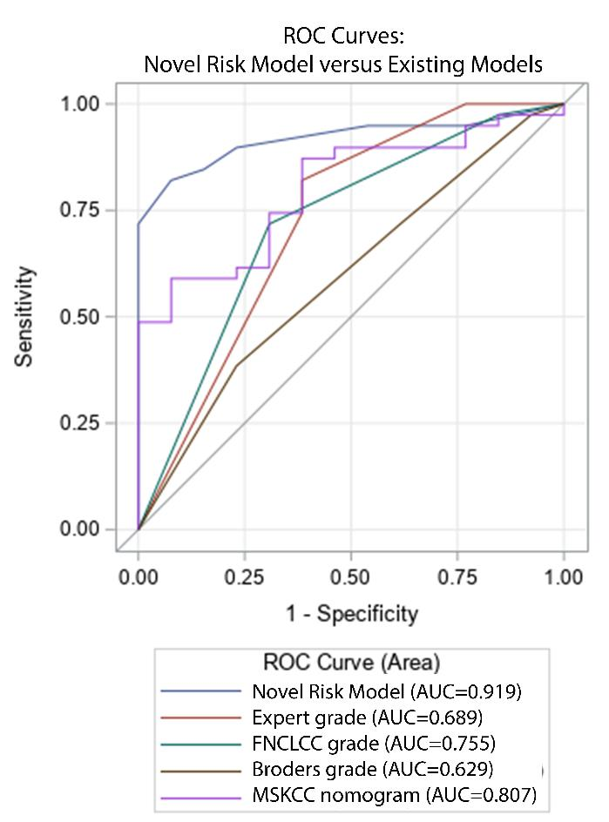
Conclusion: This novel risk model outperforms existing grading systems in stage I uterine leiomyosarcoma
System | Adjusted P for statistical difference from our novel risk model
Broders nuclear atypia score | 0.0008
French sarcoma grading system | 0.01
Expert grading | 0.02
MSKCC risk nomogram | 0.04
Notes:
An ROC curve (receiver operating characteristic curve) is a graph showing the performance of a classification model at all classification thresholds.

Slide 39
When serosa, margins, and lymphovascular invasion are not evaluable, a simplified risk model can be applied.
Score =
(Serosal involvement)(5) +
(Margin involvement)(5) +
(Lymphovascular invasion)(3) +
(Mitoses ≥25/10 hpf)(2) +
(Atypical mitoses)(2) +
(Coagulative necrosis)(1)
Score range: 0-5

Slide 40
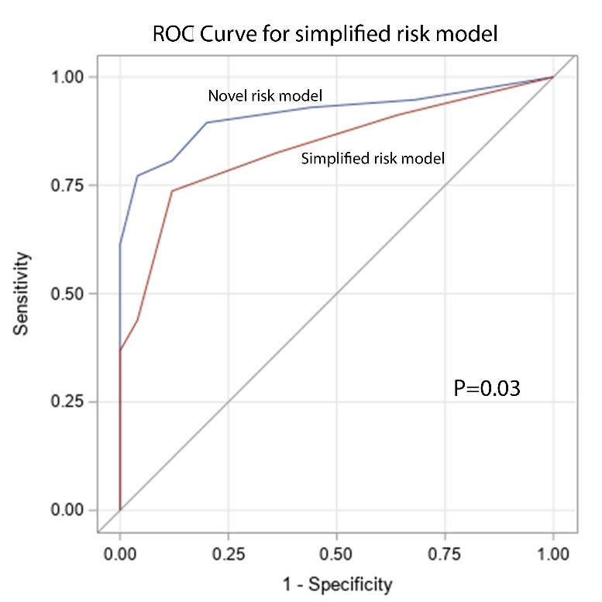
When serosa, margins, and lymphovascular invasion are not evaluable, a simplified risk model can be applied.
Score =
(Mitoses ≥25/10 hpf)(2) +
(Atypical mitoses)(2) +
(Coagulative necrosis)(1)

Slide 41
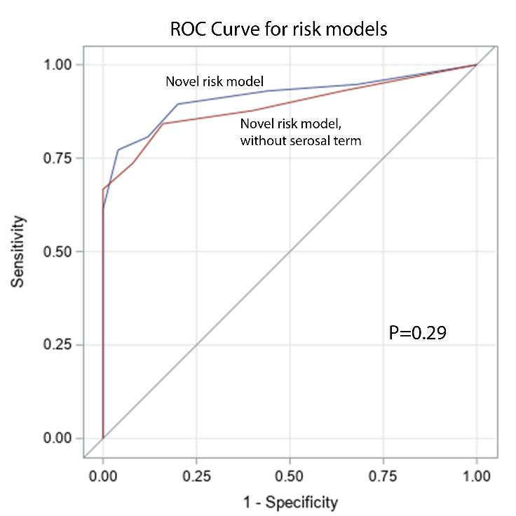
And just in case one might suggest that serosal involvement warrants designation of stage II…
Score =
(Margin involvement)(5) +
(Lymphovascular invasion)(3) +
(Mitoses ≥25/10 hpf)(2) +
(Atypical mitoses)(2) +
(Coagulative necrosis)(1)

Slide 42
This simple prognostic model accurately classifies risk of recurrence in stage I uterine leiomyosarcoma.
This morphologic model provides a foundation for analysis of potential immunophenotypic or molecular prognostic markers.
Carefully defined morphologic variables should enhance uptake in routine practice and may provide the basis for therapeutic trials.
Risk Score =
(Serosal involvement)(5) +
(Margin involvement)(5) +
(Lymphovascular invasion)(3) +
(Mitoses ≥25/10 hpf)(2) +
(Atypical mitoses)(2) +
(Coagulative necrosis)(1)

Slide 43
Challenges in Application
Serosal abutment
Coagulative necrosis
Recognizing atypical mitoses

Slide 44
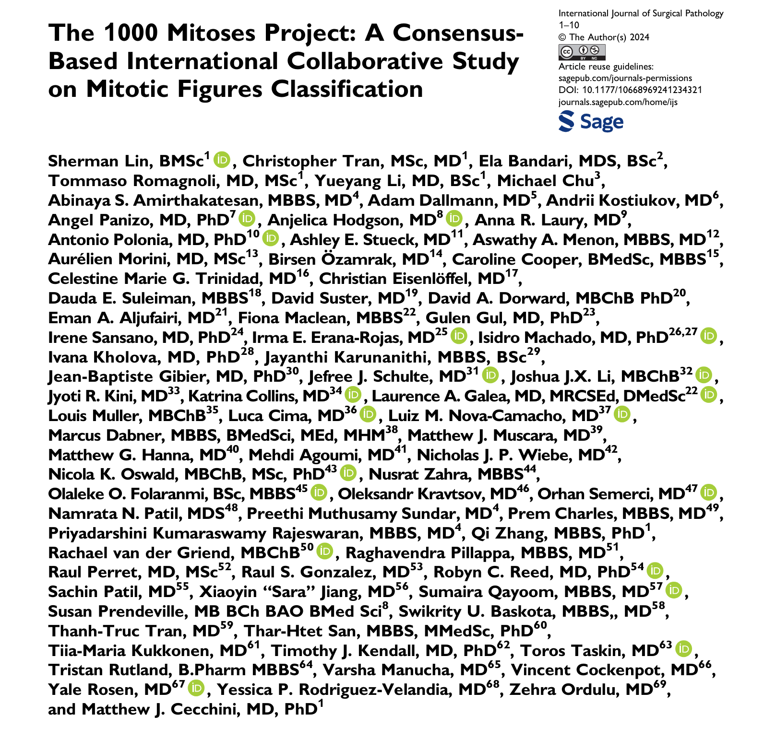

Slide 45
Study Design
Pathologists randomly selected a digital image from The Cancer Genome Atlas and annotate 10-20 mitotic figures with 2 mm² area
First 1010 submitted mitotic figures used to create an image data set of an individual tile at 40X
Data set redistributed to all pathologists to review and decide if mitotic figure (binary; yes/no)

Slide 46
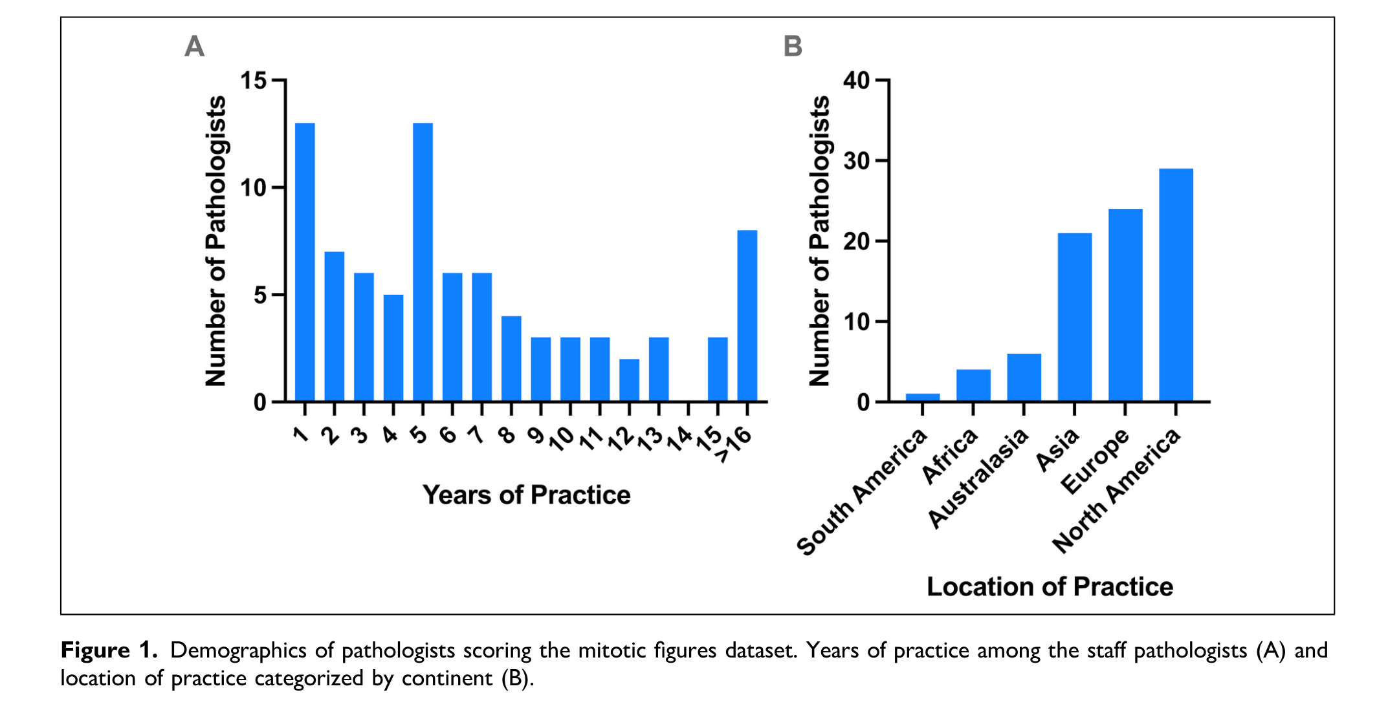
Diversity of the study participants
Notes:
Cohort of pathologists from diverse backgrounds and clinical practice settings

Slide 47
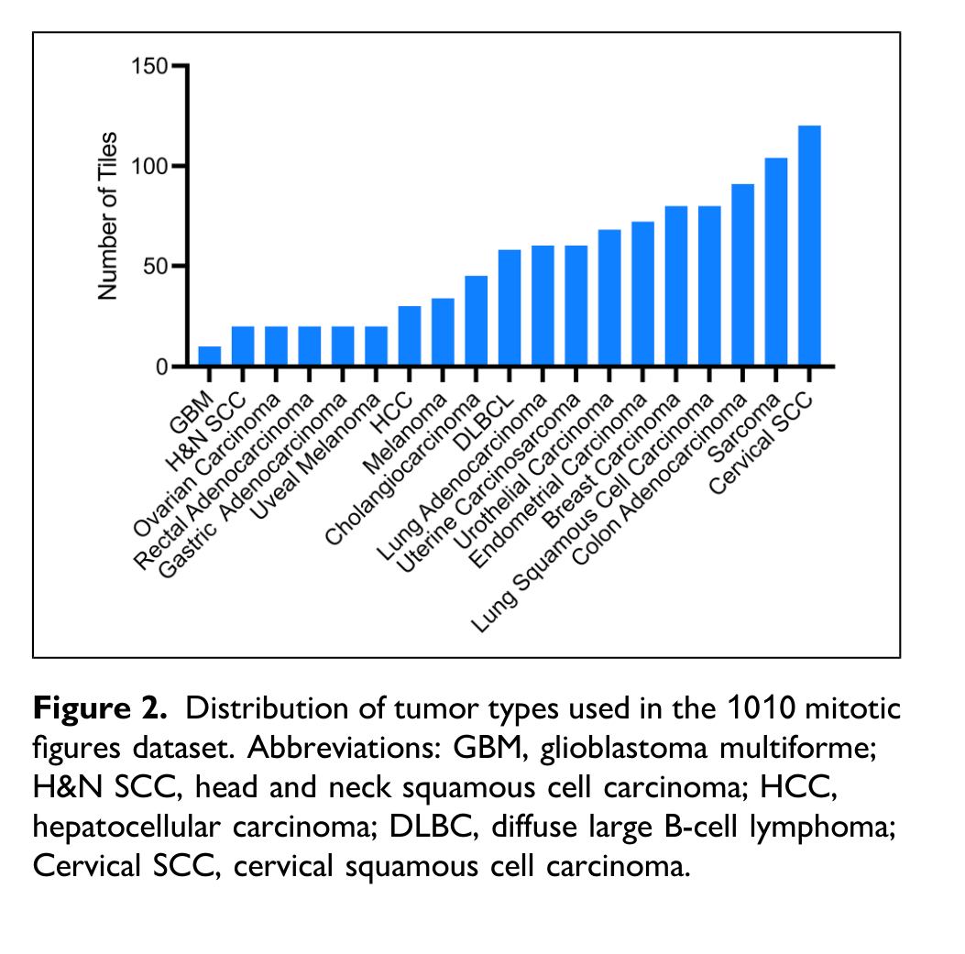

Slide 48
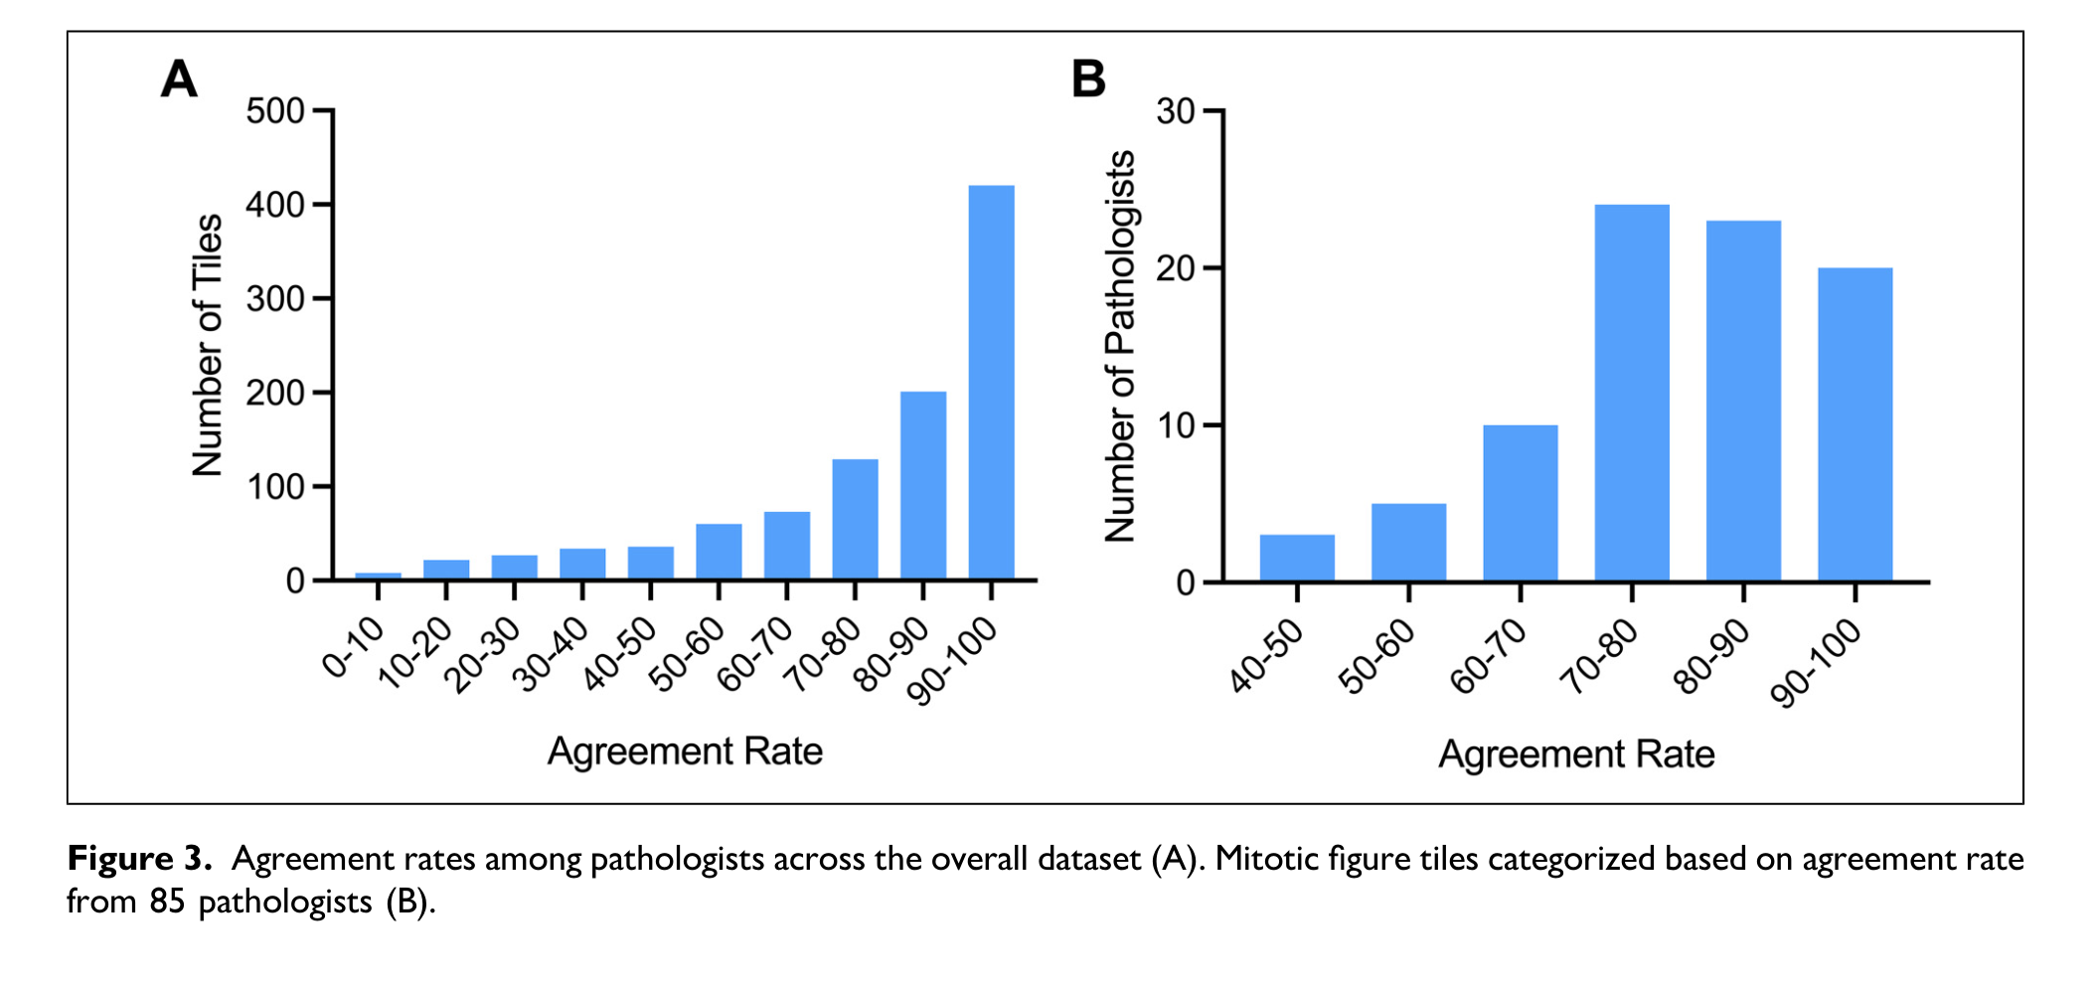
Median agreement rate of 87%
for whether an individual tile = mitosis
Median agreement rate of pathologists
= 80.2% for mitotic figures
Notes:
Range for tiles was 1.2 to 100% reflecting low agreement of some tiles

Slide 49
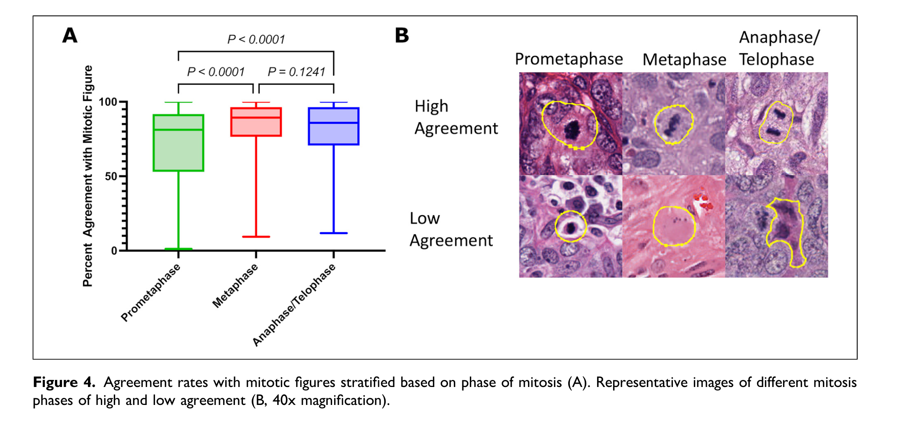

Slide 50
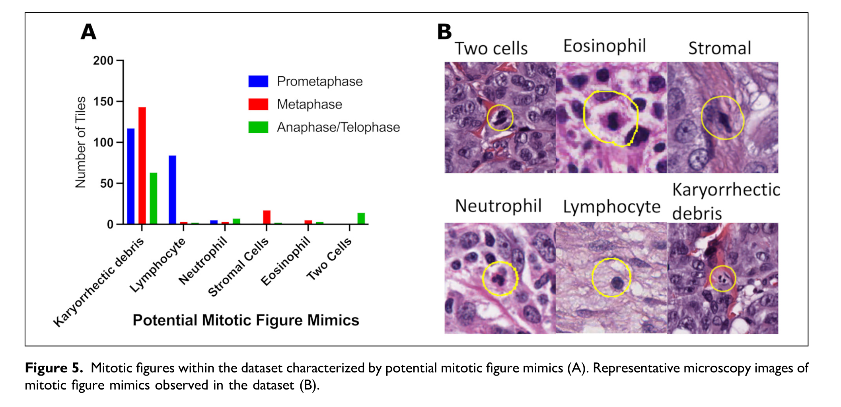
Notes:
Each mitotic figure also assessed for being a potential mimic – which was assigned in 467/1010 or 46%. The mitotic figures with lowest agreement rates were most likely to represent a mitotic figure mimic

Slide 51
Artificial Intelligence
Improve reproducibility of currently assessed pathologic features
Identify other prognostically important features that can be routinely assessed

Slide 52
Research Project
I. Survival Task
Develop a Deep Learning (DL) pipeline that can predict clinical outcomes of stage I uLMS and Identify morphological uLMS-features associated with disease recurrence.
II. Molecular classification Task
Develop a DL-pipeline that can predict druggable molecular features (eg. TP53/RB1status or HRD/BRCA) in uLMS and identify morphological uLMS-features associated with molecular alterations.
III. Diagnostic classification Task
Develop a DL-pipeline that can reliably distinguish uLMS from benign counterpart (leiomyoma variants).

Slide 53
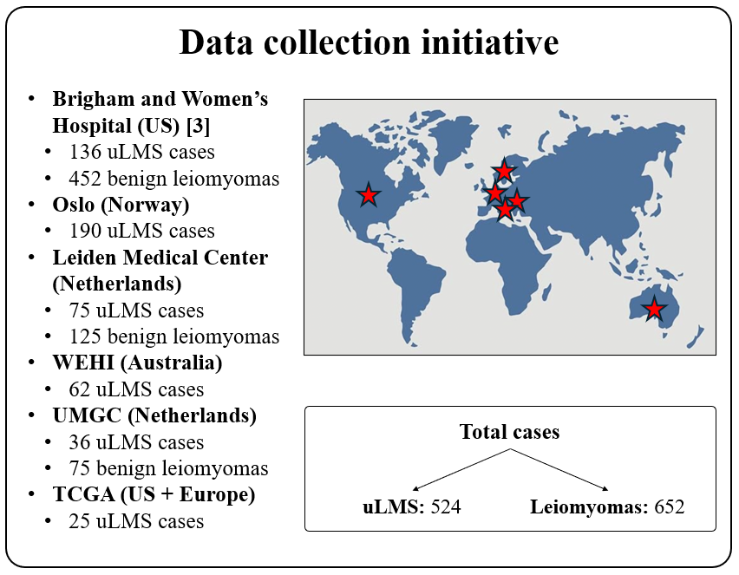

Slide 54
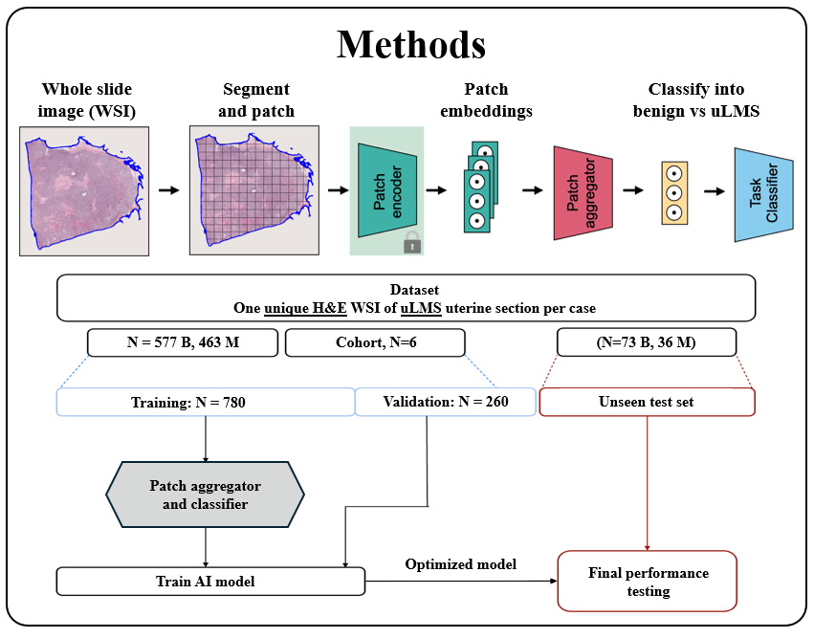

Slide 55
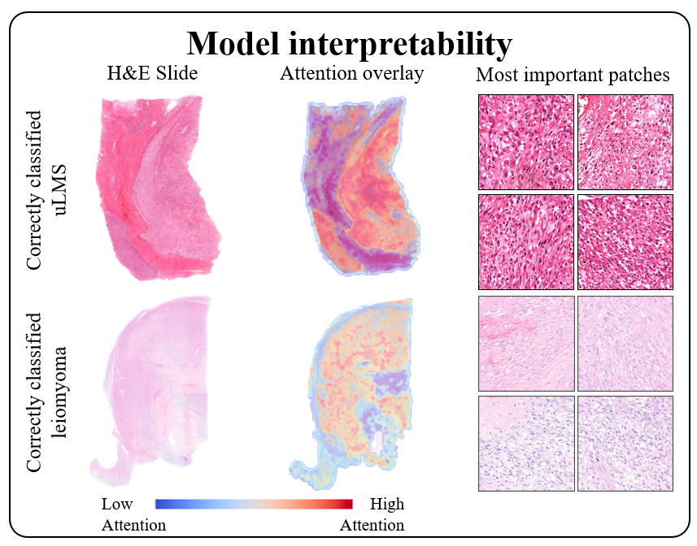

Slide 56
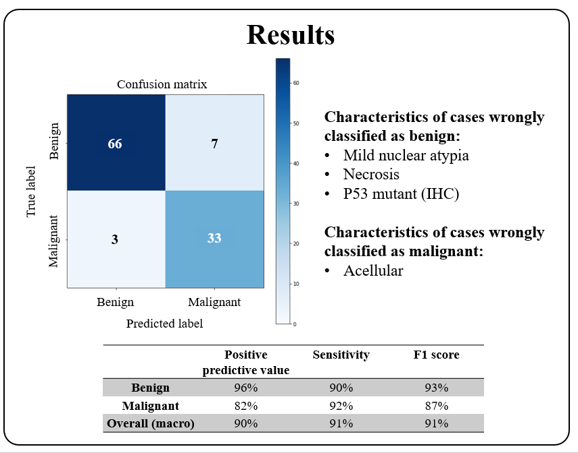

Slide 57
Conclusions
Leiomyosarcomas can be stratified into “low” and “high” grade
Novel risk stratification for “high” grade tumors to predict patient outcome in stage I disease
Role of Artificial Intelligence to help guide diagnosis, prognosis and clinical management

Slide 58
obrigadA!

